Slide 1
Keyword and Semantic Searches with ReRank
Savitha Shree M (19981)

Slide 2
TABLE OF CONTENTS
INTRODUCTION
DESIGN
IMPLEMENTATION
SAMPLE OUTPUT
CONCLUSION

Slide 3
INTRODUCTION
The project is to implement ReRank to improve keyword search and dense retrieval. ReRank offers a robust semantic enhancement to keyword or vector search systems without necessitating a complete overhaul.
By leveraging Cohere and Weaviate, we can implement this enhancement seamlessly.
sentiment analysis
text classification
named entity recognition
machine translation

Slide 4
DESIGN
It is built in Python Programming language.
The four major steps involved are:
Use Cohere and Weaviate with its API keys.
Apply dense retrieval to query
Improve keyword search with ReRank
Improve dense retrieval with ReRank

Slide 5
DESIGN
Cohere: A platform or system designed for various natural language processing (NLP) and text-related tasks.
Weaviate: An open-source vector search engine used for storing, searching, and retrieving data vectors.
Dense Retrieval: An information retrieval technique that leverages dense embeddings (vectors) to retrieve relevant data or documents.
Keyword Search: A traditional search method that relies on keywords or terms to retrieve matching documents or data.
ReRank: A process used to improve the performance of both Dense Retrieval and Keyword Search by reordering or re-ranking search results to enhance relevance and accuracy.

Slide 6
INSTALLATION
Create python virtual environment
sudo apt install python3.10 -venv
Install the required packages
python -m venv env
source env/bin/activate
pip install cohere
pip install weaviate-client

Slide 7
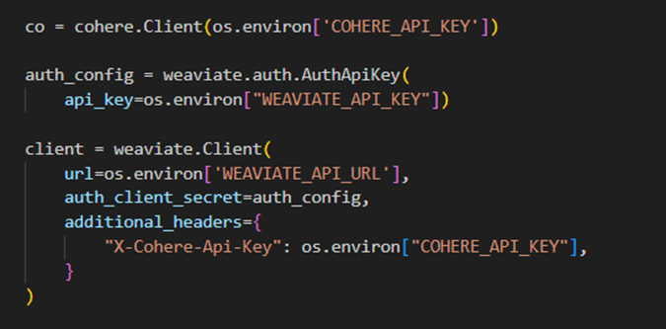
IMPLEMENTATION
USE COHERE AND WEAVIATE: Install cohere and weaviate-client and use the API keys

Slide 8
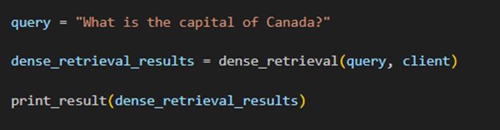
IMPLEMENTATION
APPLY DENSE RETRIEVAL TO QUERY:

Slide 9
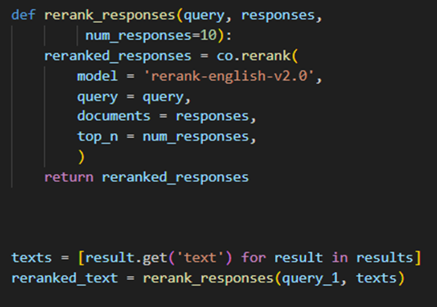
IMPLEMENTATION
IMPROVE KEYWORD SEARCH WITH RERANK:
The rerank function looks like:

Slide 10
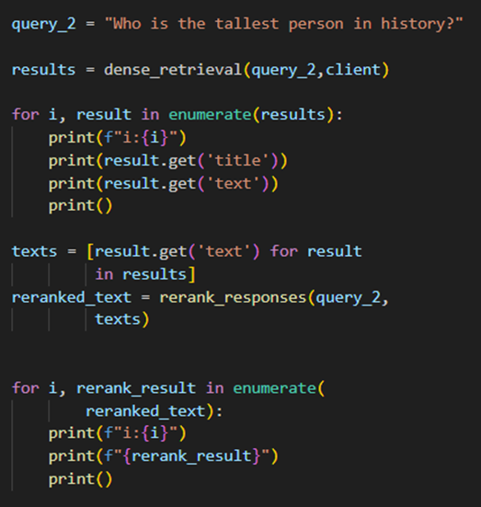
IMPLEMENTATION
IMPROVE DENSES RETRIEVAL WITH RERANK:

Slide 11
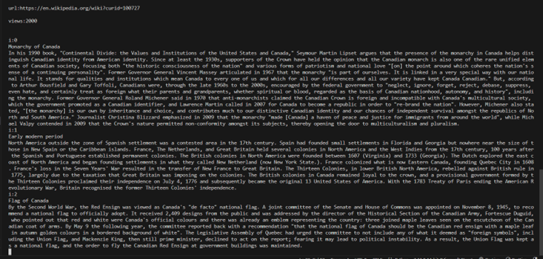
SAMPLE OUTPUT

Slide 12
CONCLUSION
GITHUB LINK:
https://github.com/savithashreem07/Fine-Tuning/tree/feature/fine-tune-drug/Keyword%20and%20Semantic%20searches%20with%20ReRank
REFERENCES:
https://learn.deeplearning.ai/courses/large-language-models-semantic-search/lesson/4/dense-retrieval
https://hc.labnet.sfbu.edu/~henry/sfbu/course/deeplearning_ai/llm_semantic_search/slide/ReRank.html

